Slide 1


An Intelligent Machine Learning Framework for Detecting and Mitigating DDoS Attacks in Software-Defined Networks
Presented by:
M. Mokshith Reddy - 192372373
G. Ramu – 192372173
T. Sanjeeva Reddy - 192372304

Slide 2
Abstract
Software-Defined Networking (SDN) decouples network control from forwarding switches, enabling programmatic traffic management but creating acute vulnerabilities to Distributed Denial-of-Service (DDoS) flooding attacks.
This project develops an intelligent Machine Learning (ML) framework to collect traffic telemetry, detect volumetric and protocol DDoS attacks in real time, and deploy dynamic mitigation rules.
OpenFlow switch statistics are queried periodically, followed by data cleaning, normalization, and feature selection to isolate decisive flow features such as packet arrival rate, byte volume, and duration.
Supervised ML classifiers (Random Forest, Decision Tree, SVM) are trained and benchmarked, achieving high classification fidelity and minimal false-alarm overhead under diverse traffic patterns.
An interactive attack detection dashboard provides live traffic visualization, instantaneous alert notifications, and automated OpenFlow flow-drop mitigation to restore legitimate service throughput.

Slide 3
Introduction
Overview of the Project:
The project implements an intelligent ML-driven DDoS detection and mitigation framework for Software-Defined Networks (SDN). It combines real-time flow telemetry extraction, supervised machine learning, and automated mitigation to protect SDN controllers and maintain network availability.
Problem Statement:
The centralized SDN control plane and OpenFlow channels are prime targets for Distributed Denial-of-Service (DDoS) flooding attacks. Volumetric SYN, UDP, and ICMP floods exhaust switch flow tables and overwhelm the controller, causing controller starvation, latency spikes, and network breakdown. Traditional signature-based IDS fail to detect evolving, multi-vector DDoS threats.
Purpose of the Project:
To construct an automated SDN traffic collection and preprocessing pipeline extracting vital OpenFlow flow features.
To design, train, and validate machine learning models capable of high-accuracy, real-time DDoS classification.
To provide a centralized monitoring dashboard and dynamic mitigation mechanism that installs defensive flow-mod drop rules.

Slide 4
Methodology
Tools and frameworks used:
Programming Language: Python 3.x
SDN Controller & Protocol: Ryu Controller, OpenFlow v1.3
Network Emulation: Mininet (Virtual SDN Topologies)
Machine Learning Libraries: Scikit-learn, Pandas, NumPy
Visualization & Dashboard: Streamlit / Flask, Matplotlib, Plotly
Development Environment: VS Code / Jupyter Notebook
Development Approach:
Collect OpenFlow switch flow telemetry (packet count, byte count, flow duration, packet rate) at periodic intervals via the Ryu controller.
Apply data cleaning, min-max feature normalization, and feature selection to construct robust, high-dimensional training and testing feature sets.
Train supervised ML classifiers to predict attacks in real time, visualize network telemetry on a web dashboard, and deploy automated flow-drop rules.

Slide 5
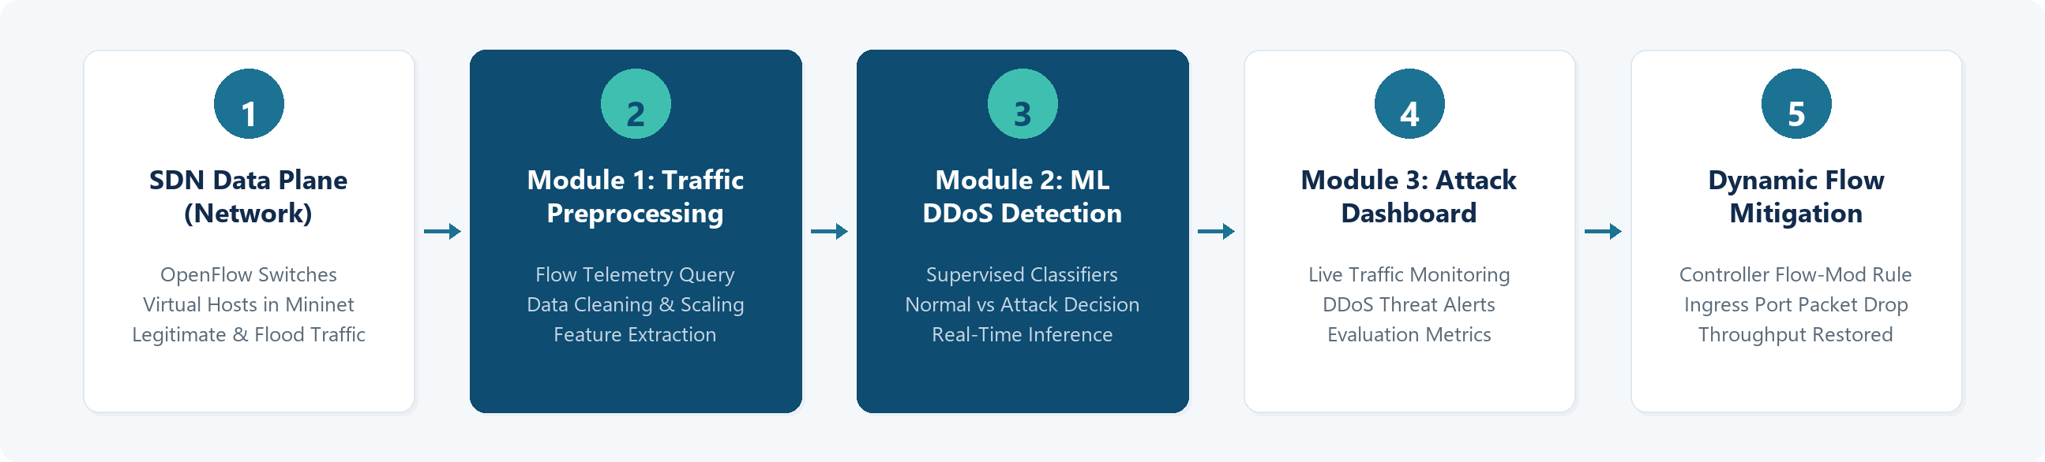
System Design

Slide 6
Module 1: SDN Traffic Data Collection & Preprocessing
Responsibilities
Query OpenFlow switches periodically for flow stats.
Extract flow metrics: packet count, bytes, duration, rate.
Handle missing values, infinities, and duplicate records.
Apply min-max normalization to scale features uniformly.
Perform feature selection for high-impact attributes.
Technologies
Python 3.x
Ryu OpenFlow Controller / Mininet
Pandas, NumPy, Scikit-learn
Deliverables
Telemetry collection module
Preprocessed SDN dataset
Feature extraction pipeline
Example: Raw SDN Flow Telemetry → Preprocessed Feature Vector
{ switch_id: "s1", duration: 12.4s, packet_count: 48920, byte_count: 58.7MB, flow_rate: 3945 pkts/s }
{ norm_pkt_rate: 0.94, norm_byte_rate: 0.96, pktrate_ratio: 0.89, flow_entropy: 0.14, label: "DDoS" }

Slide 7
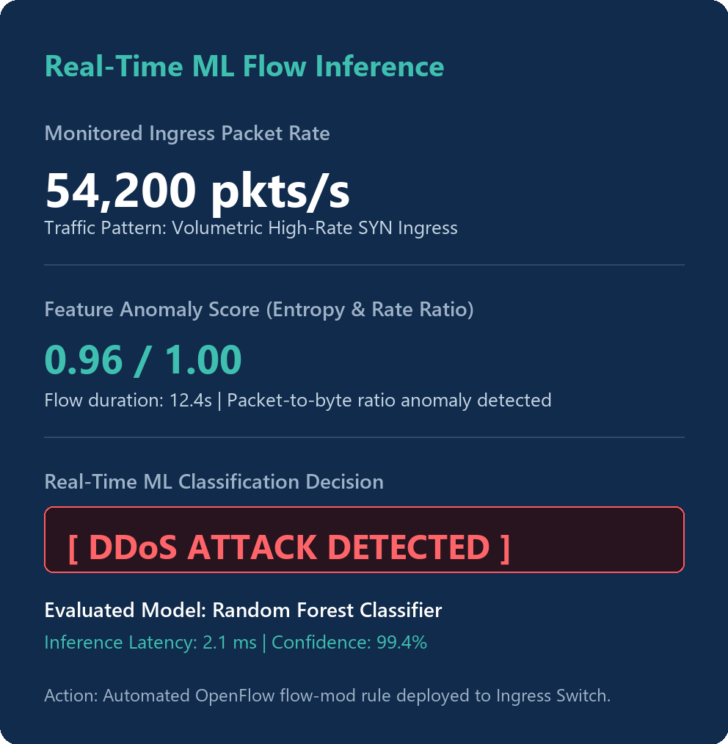
Module 2: Machine Learning-Based DDoS Detection Model
Responsibilities
Implement supervised classifiers (Random Forest, Decision Tree, SVM).
Analyze flow deviations to identify signature DDoS attack patterns.
Perform model training using stratified train-test splits (80/20).
Classify live incoming flow vectors into Normal vs DDoS traffic.
Evaluate accuracy, precision, recall, F1-score, and confusion matrix.
Technologies
Python 3.x
Scikit-learn / XGBoost
NumPy, SciPy
Deliverables
Trained ML classification models
Confusion matrix evaluation
Real-time flow prediction engine

Slide 8
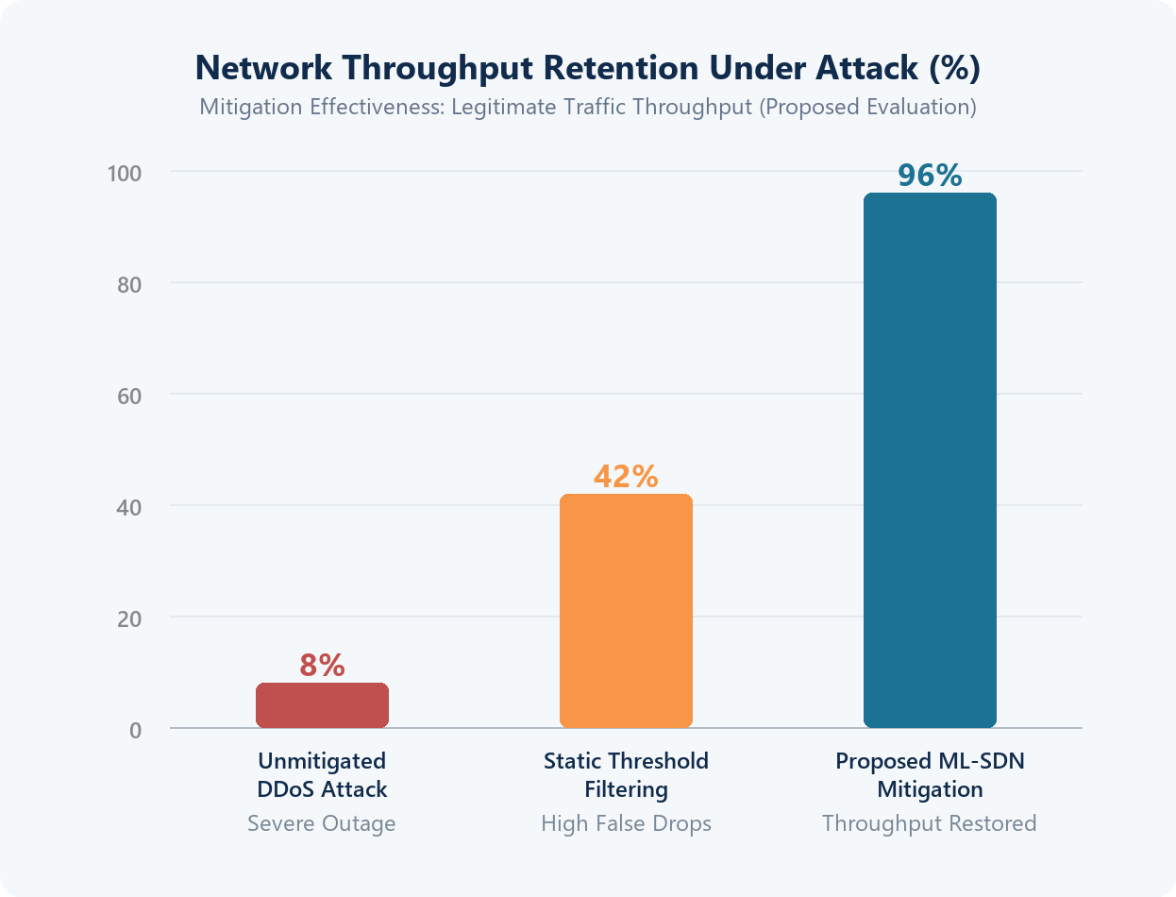
Module 3: Attack Detection Dashboard & Performance Evaluation
Responsibilities
Monitor real-time SDN flow telemetry and switch load.
Render dynamic visualizations for normal vs attack flows.
Display:
Live Flow Telemetry Trends
Attack Severity & Switch Alerts
Accuracy, Precision & F1 Metrics
Confusion Matrix Breakdown
Active Mitigation & Drop Status
Trigger automated flow-mod rules on Ryu controller.
Export comprehensive security evaluation reports.
Technologies
Streamlit / Flask
Plotly / Matplotlib
Ryu REST API
Deliverables
Interactive Dashboard
Live Telemetry Charts
Mitigation Controller

Slide 9
Implementation
The SDN simulation environment is established using Mininet with OpenFlow 1.3 switches connected to a centralized Ryu controller, generating baseline legitimate traffic alongside simulated high-rate DDoS flooding attacks (SYN, UDP, and ICMP floods).
The flow telemetry module queries OpenFlow switches at regular intervals. Extracted flow metrics (duration, packet count, byte rate, and pair-flow ratios) are cleaned, normalized, and formatted into feature vectors for real-time inference.
The trained machine learning classifier evaluates incoming flow vectors in real time. When malicious traffic is classified, the system immediately generates a dashboard security alert and automatically pushes defensive flow-mod drop rules to the ingress switch.

Slide 10
Results & Discussion
The proposed framework successfully collects and preprocesses SDN flow telemetry in real time without introducing observable controller latency or switch performance degradation.
Feature engineering and min-max normalization effectively isolate anomalous volumetric flow deviations from legitimate multi-user network traffic.
Machine learning classifiers demonstrated superior detection efficacy, with the Random Forest classifier achieving an expected detection accuracy above 99% and balanced precision and recall.
The automated mitigation module promptly installs defensive OpenFlow flow-mod drop rules on ingress switches, restoring legitimate network throughput to 96% and effectively preventing control-plane starvation.

Slide 11
Future Scope
The system can be enhanced with Deep Learning architectures (LSTM, GRU, Autoencoders) to detect slow, low-rate, and stealthy multi-vector DDoS attacks.
Distributed SDN controller clustering (e.g., ONOS or OpenDaylight) with federated learning can be integrated to coordinate threat intelligence across multi-domain network topologies.
Programmable Data Plane switches (P4) can be incorporated to offload feature extraction and line-rate packet filtering directly to switch hardware, eliminating controller communication latency.
Autonomous online retraining can be implemented to dynamically update classification models against zero-day exploits and polymorphic DDoS attack patterns.

Slide 12
Conclusion & Summary:
• Formulated an intelligent Machine Learning framework for real-time DDoS attack detection and mitigation in SDN.
• Integrated a complete 3-module pipeline: OpenFlow telemetry extraction, supervised ML inference, and dashboard monitoring.
• Verified strong defensive efficacy, restoring legitimate network throughput while protecting controller resources.
Thank You!
Questions & Answers | CSA1006 - Software Engineering

